Slide 1
Friend Class and Function in C++

Slide 2
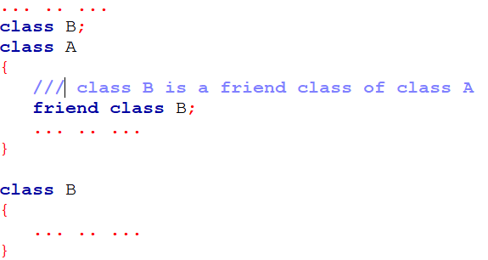
Friend Class
Friend Class A friend class can access private and protected members of other class in which it is declared as friend.
It is sometimes useful to allow a particular class to access private members of other class.
For example a LinkedList class may be allowed to access private members of Node.

Slide 3
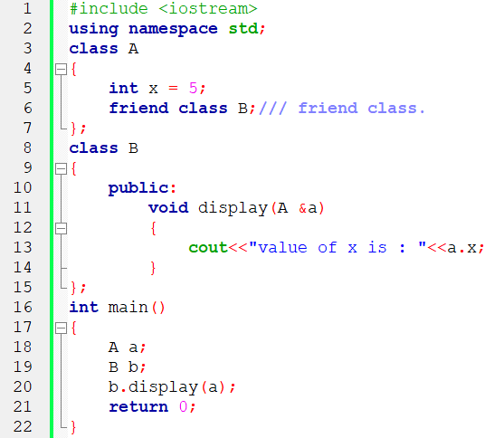
Example of Friend Class

Slide 4
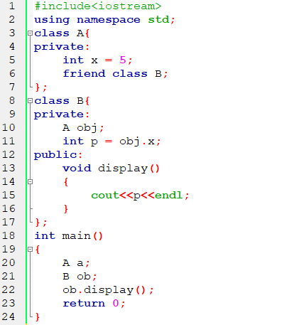
Example-02 of Friend Class

Slide 5

Friend Function
If a function is defined as a friend function in C++, then the protected and private data of a class can be accessed using the function.
By using the keyword friend compiler knows the given function is a friend function.
For accessing the data, the declaration of a friend function should be done inside the body of a class starting with the keyword friend.
In the above declaration, the friend function is preceded by the keyword friend. The function can be defined anywhere in the program like a normal C++ function. The function definition does not use either the keyword friend or scope resolution operator.

Slide 6
Characteristics of Friend Function
The function is not in the scope of the class to which it has been declared as a friend.
It cannot be called using the object as it is not in the scope of that class.
It can be invoked like a normal function without using the object.
It cannot access the member names directly and has to use an object name and dot membership operator with the member name.
It can be declared either in the private or the public part.

Slide 7
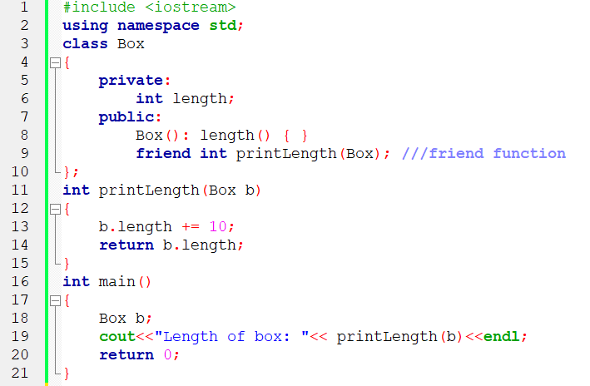
Example of Friend Function

Slide 8
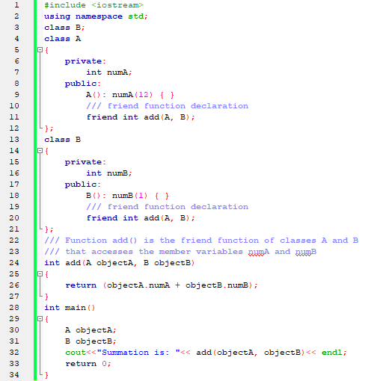
Addition of members of two different classes using friend Function

Slide 9
Interfaces in C++ (Abstract Classes)
Abstract classes are the way to achieve abstraction in C++. Abstraction in C++ is the process to hide the internal details and showing functionality only. Abstraction can be achieved by two ways:
Abstract class
Interface
Abstract class and interface both can have abstract methods which are necessary for abstraction.
In C++ class is made abstract by declaring at least one of its functions as <>strong>pure virtual function. A pure virtual function is specified by placing "= 0" in its declaration. Its implementation must be provided by derived classes.

Slide 10
Interfaces
An interface describes the behavior or capabilities of a C++ class without committing to a particular implementation of that class.
The C++ interfaces are implemented using abstract classes and these abstract classes should not be confused with data abstraction which is a concept of keeping implementation details separate from associated data.
A class is made abstract by declaring at least one of its functions as pure virtual function. A pure virtual function is specified by placing "= 0" in its declaration as follows −

Slide 11
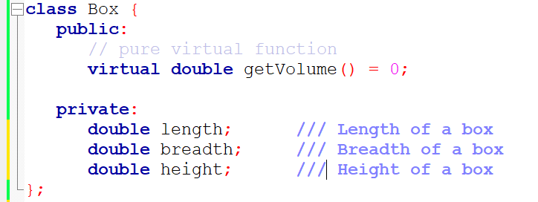
Interfaces

Slide 12
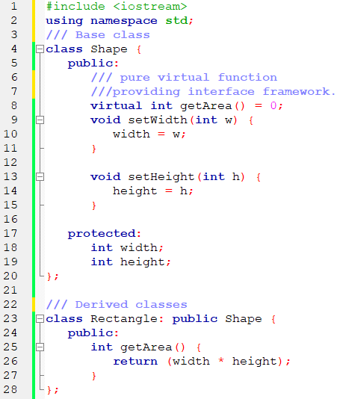
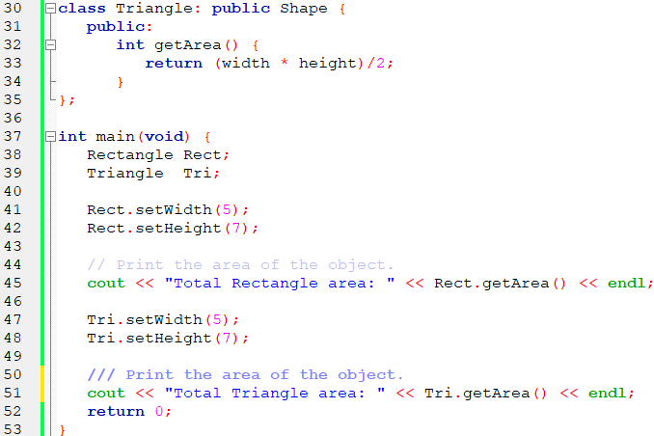
Example of Abstract Class
Consider the following example where parent class provides an interface to the base class to implement a function called getArea() −

Slide 13
Thank You

